Slide 1
Mathematical Foundations for ML (10-606):
Probability
Bryan Wilder
* Slides borrowed from prior offerings by Professors M. Gormley, P. Virtue, & G. Gordon, & H. Heidari.

Slide 2
Problem
Suppose that you roll a dice that comes up either 1, 2, 3, or 4. However, the dice is weighted and may not have uniform probabilities. Let:
A be the event that you roll either a 1 or a 3
B be the event that you roll a 2, 3, or 4
C be the event that you roll a 1
D be the event that you roll a 2 or a 4
Suppose that P(A) = 0.4, P(B) = 0.7, and P(C) = 0.3. What is P(D)?

Slide 3
Problem
Suppose that you roll a dice that comes up either 1, 2, 3, or 4. However, the dice is weighted and may not have uniform probabilities. Let:
A be the event that you roll either a 1 or a 3
B be the event that you roll a 2, 3, or 4
C be the event that you roll a 1
D be the event that you roll a 2 or a 4
Suppose that P(A) = 0.4, P(B) = 0.7, and P(C) = 0.1. What is P(D)?
P({3}) = P(A) – P(C) = 0.1
P(D) = P({2, 4}) = P(B) – P({3}) = 0.6

Slide 4
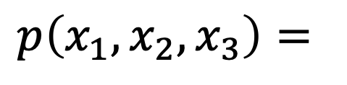
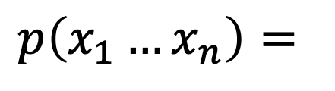
The Chain Rule
More generally, can always write any joint distribution as an incremental product of conditional distributions
$$p\left(x_{1}, x_{2},x_{3}\right)=$$
$$p\left(x_{1}…x_{n}\right)=$$
Notes:
Show multiple different factorizations

Slide 5
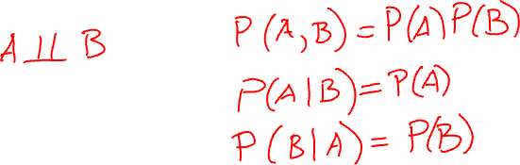
Independence
Variables where knowing one does not reveal any information about the other
Notes:
A \perp B
P(A, B) = P(A, B)
P(A|B) = P(A)
P(B|A) = P(B)

Slide 6

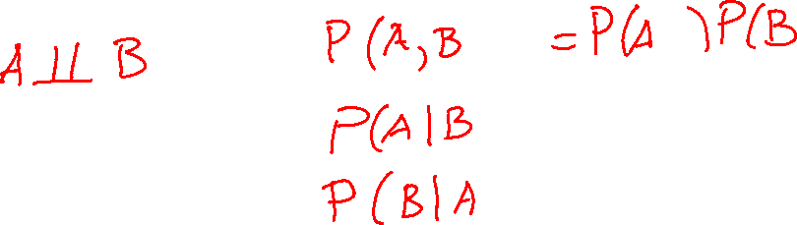
Conditional Independence

Slide 7
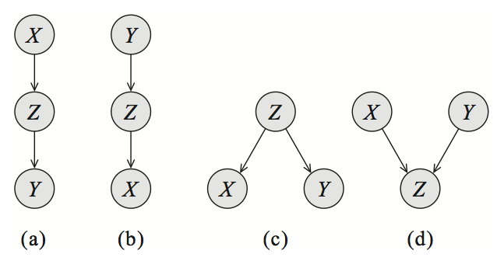
Probabilistic graphical models
Model data by describing what conditional independent relationships we believe hold vs which variables are dependent

Slide 8
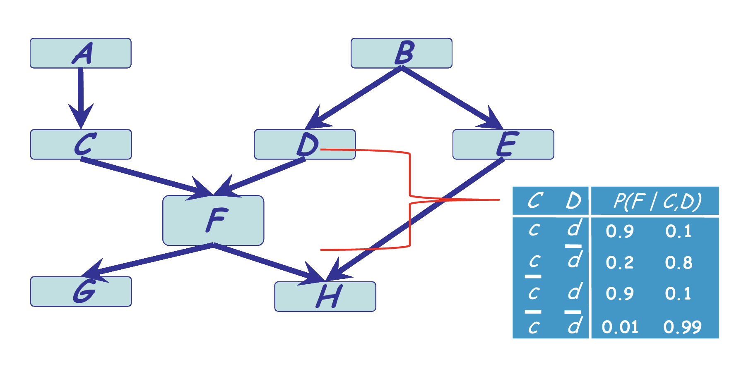
Bayesian network

Slide 9
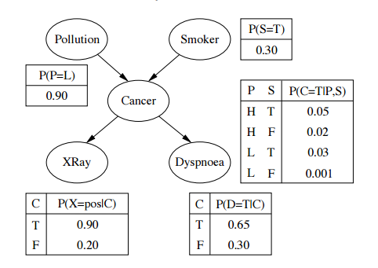

Slide 10
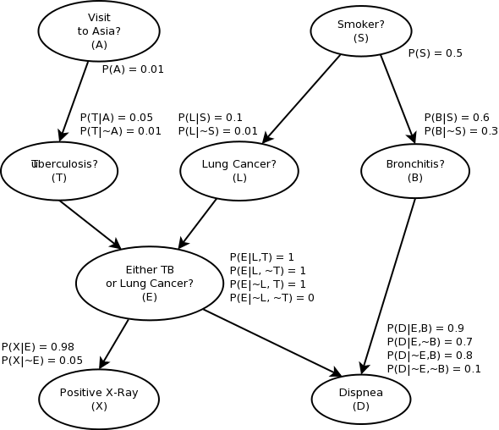

Slide 11
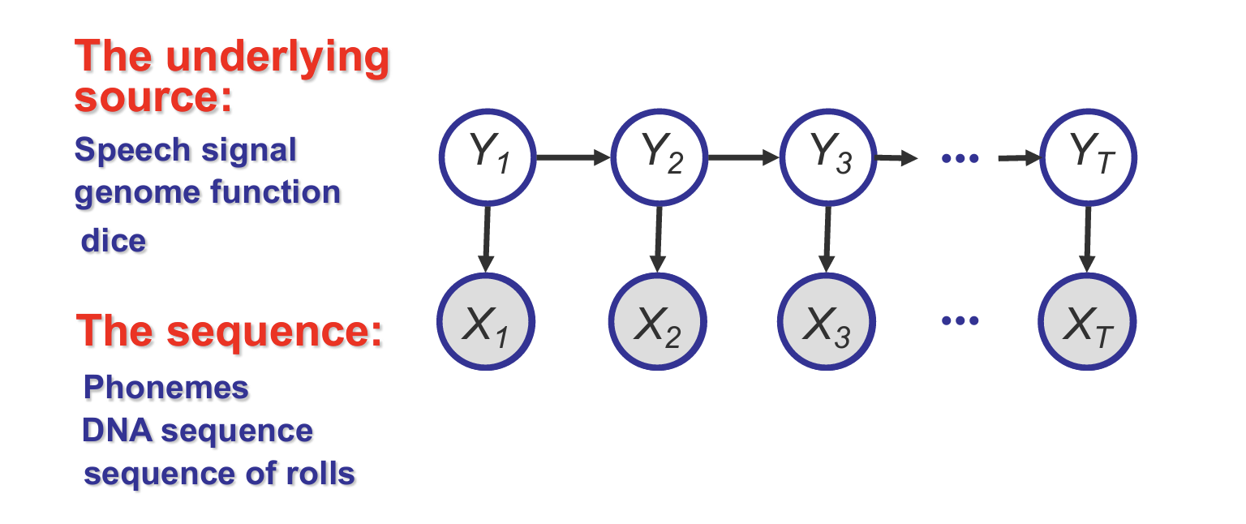
Hidden Markov model

Slide 12
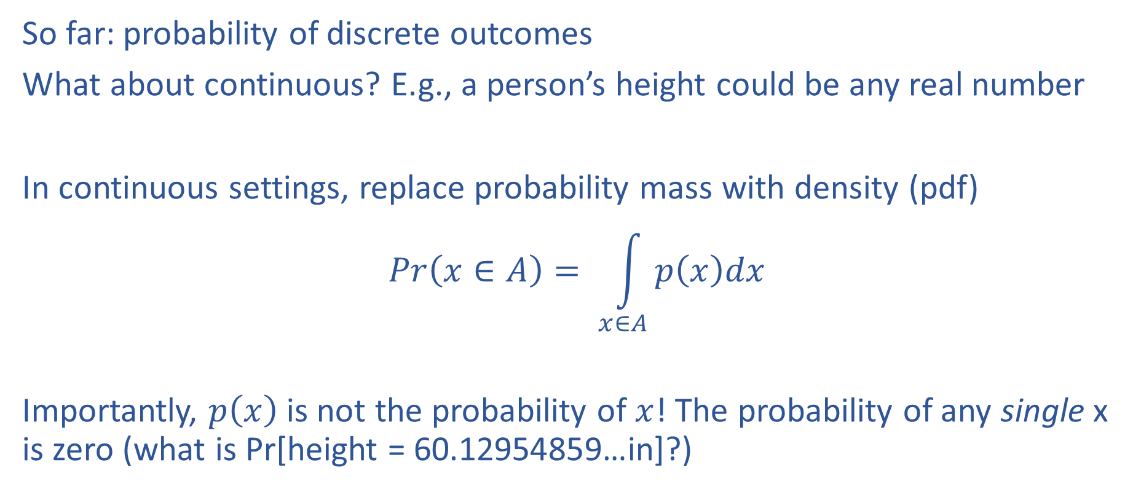
Continuous distributions
So far: probability of discrete outcomes
What about continuous? E.g., a person’s height could be any real number
In continuous settings, replace probability mass with density (pdf)
$$Pr\left(x∈A\right)= \int_{x∈A}{p\left(x\right)dx}$$
Importantly, $p\left(x\right)$ is not the probability of $x$! The probability of any single x is zero (what is Pr[height = 60.12954859…in]?)

Slide 13
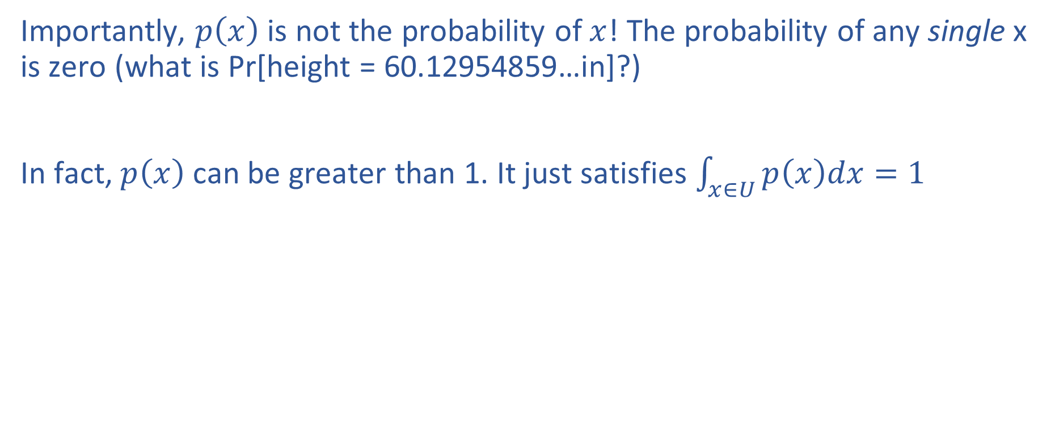
Continuous distributions
Importantly, $p\left(x\right)$ is not the probability of $x$! The probability of any single x is zero (what is Pr[height = 60.12954859…in]?)
In fact, $p\left(x\right)$ can be greater than 1. It just satisfies $\int_{x∈U}{p\left(x\right)dx=1}$

Slide 14
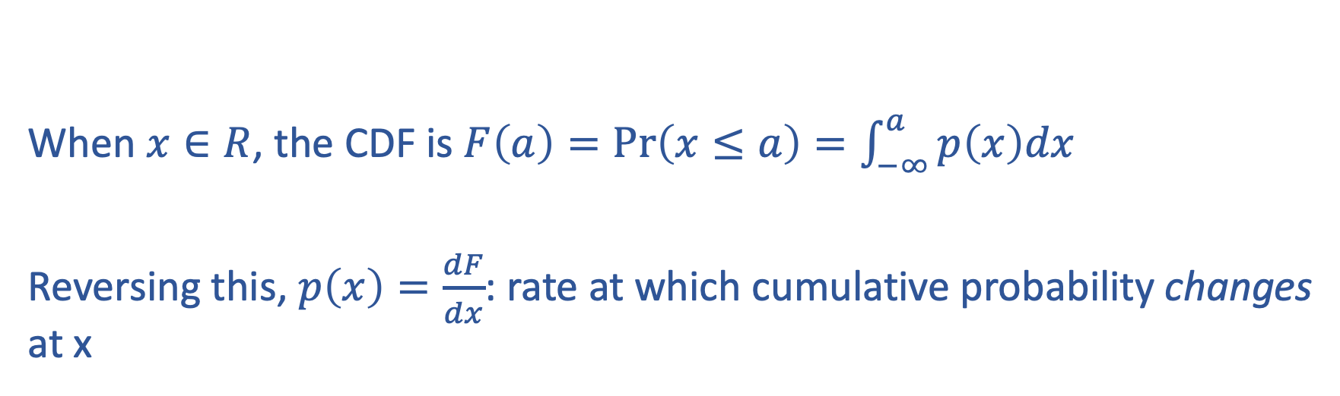
Cumulative distribution functions
When $x∈R$, the CDF is $F\left(a\right)=\operatorname{Pr}\left(x≤a\right)=\int_{−∞}^{a}{p\left(x\right)dx}$
Reversing this, $p\left(x\right)=\frac{dF}{dx}$: rate at which cumulative probability changes at x

Slide 15
Parametric distributions
Common families of distributions which set a functional form for the mass or density function
Go-to tools for writing down models, doing analysis, etc

Slide 16
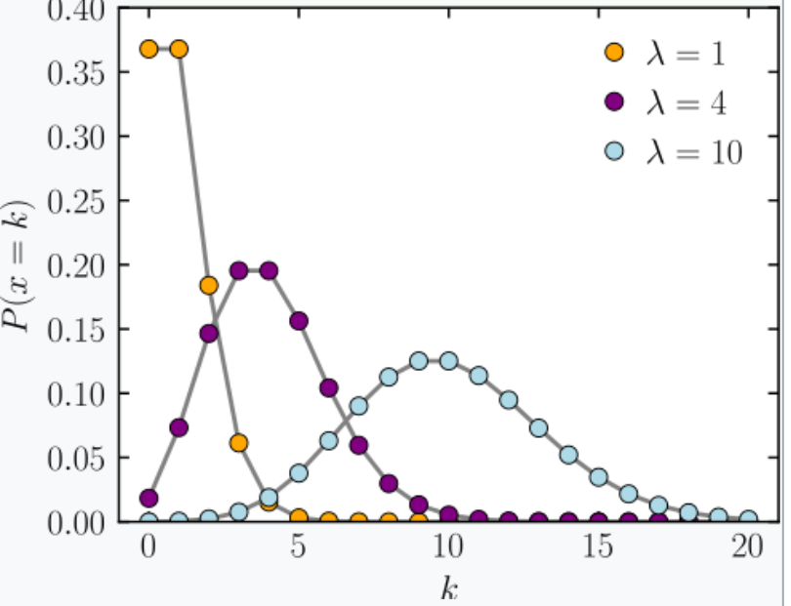
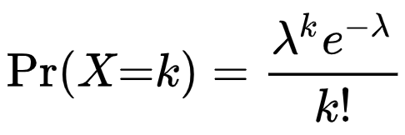
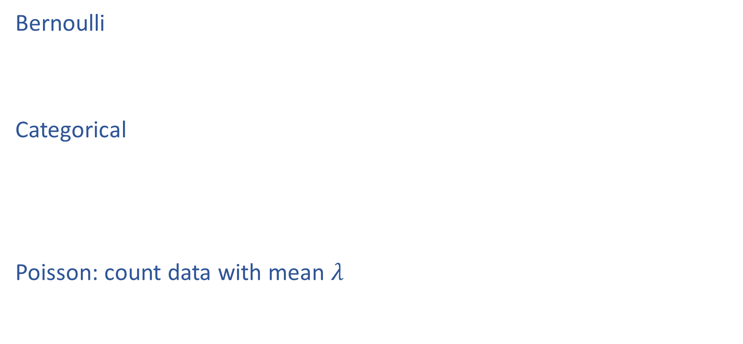
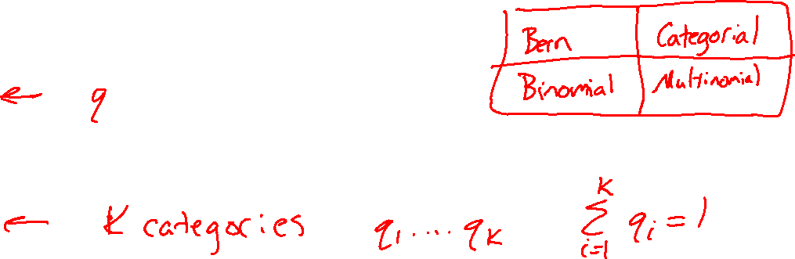
Example Discrete Distributions
Bernoulli
Categorical
Poisson: count data with mean $λ$
https://en.wikipedia.org/wiki/Poisson_distribution

Slide 17
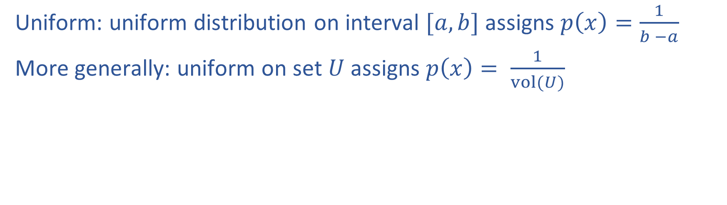
Continuous distributions
Uniform: uniform distribution on interval $[a,b]$ assigns $p\left(x\right)=\frac{1}{b −a}$
More generally: uniform on set $U$ assigns $p\left(x\right)= \frac{1}{vol(U)}$

Slide 18
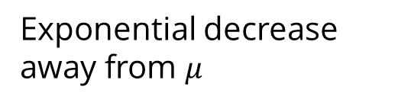
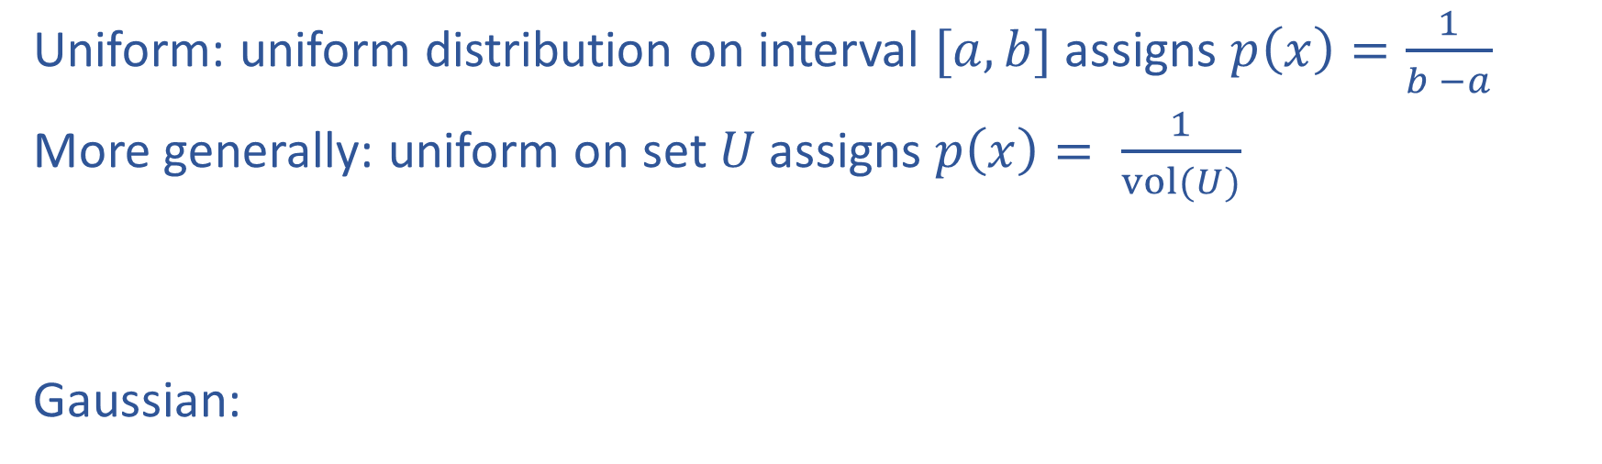
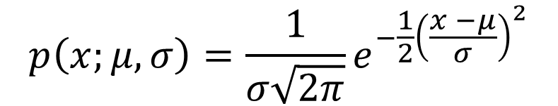
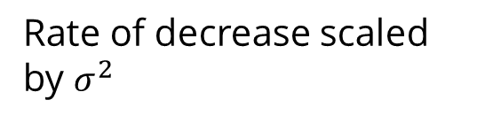
Continuous distributions
Uniform: uniform distribution on interval $[a,b]$ assigns $p\left(x\right)=\frac{1}{b −a}$
More generally: uniform on set $U$ assigns $p\left(x\right)= \frac{1}{vol(U)}$
Gaussian:
Exponential decrease away from $μ$
$$p\left(x;μ, σ\right)=\frac{1}{σ\sqrt{2π}}e^{−\frac{1}{2}{\left(\frac{x −μ}{σ}\right)}^{2}}$$
Rate of decrease scaled by $σ^{2}$
mean
Standard deviation

Slide 19
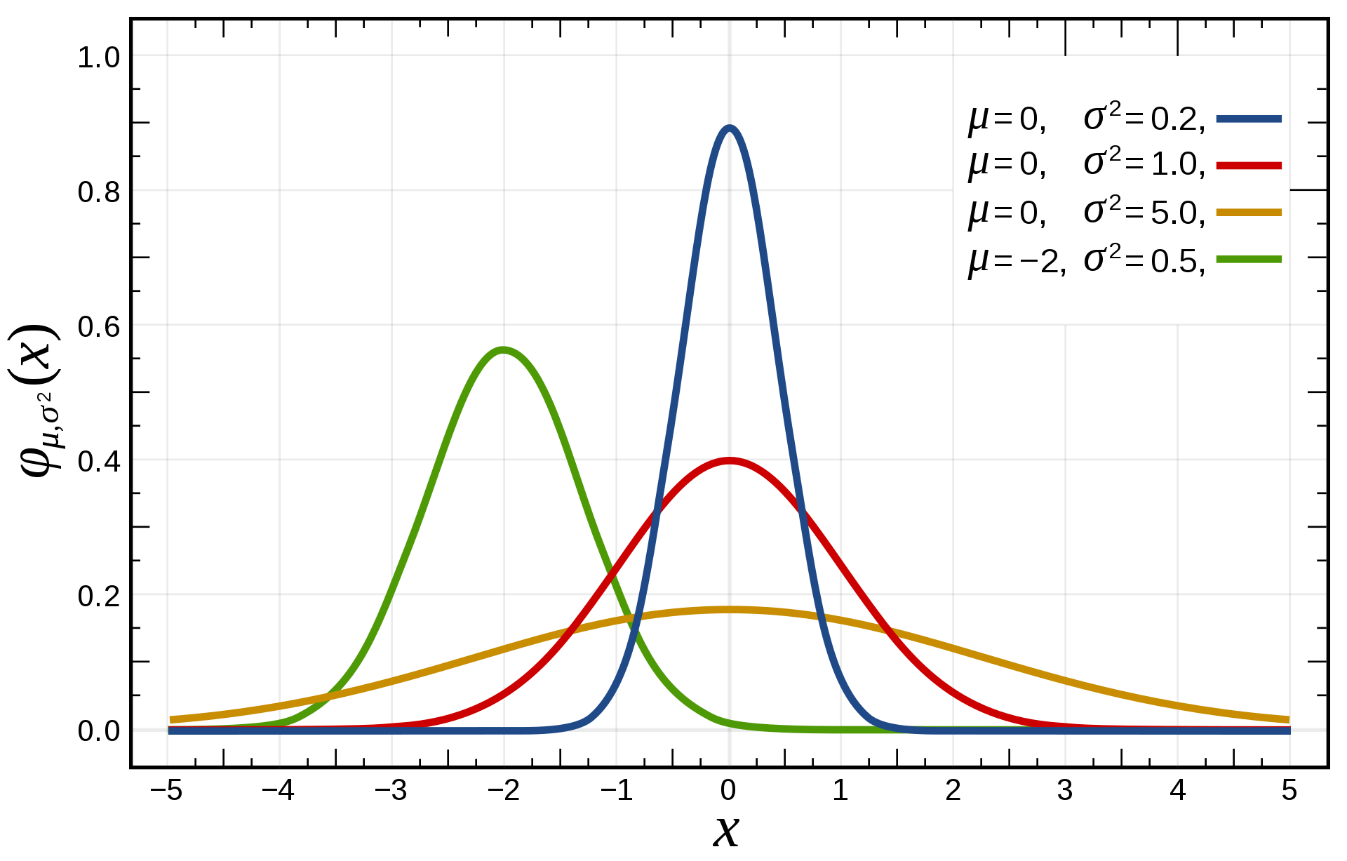
$$p\left(x;μ, σ\right)$$

Slide 20
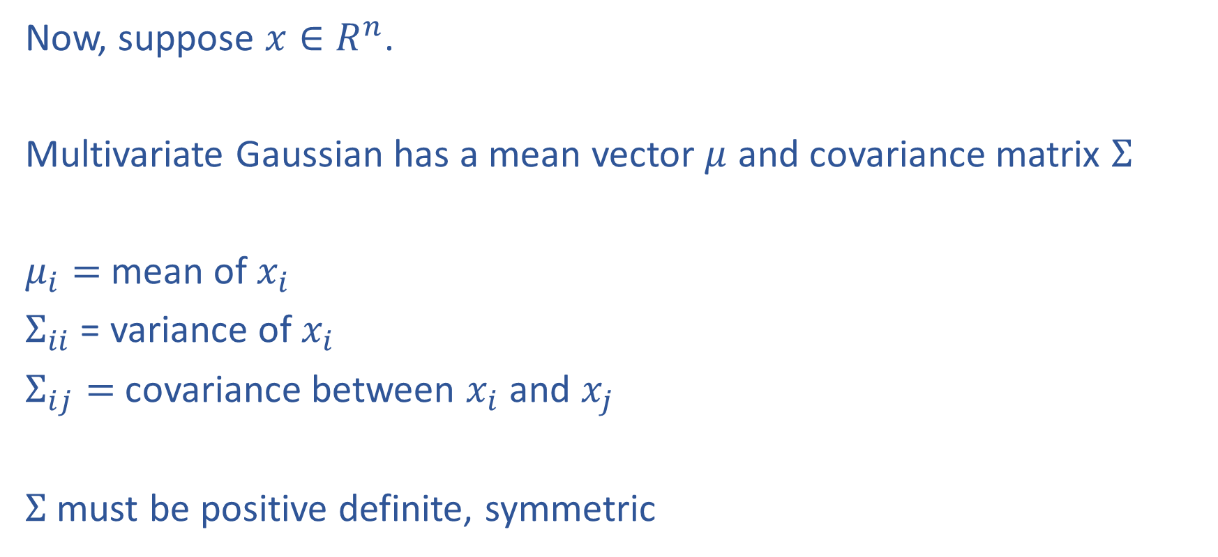
Multivariate Gaussian
Now, suppose $x∈R^{n}$.
Multivariate Gaussian has a mean vector $μ$ and covariance matrix $Σ$
$μ_{i}=$mean of $x_{i}$
$Σ_{ii}$ = variance of $x_{i}$
$Σ_{ij}=$covariance between $x_{i}$ and $x_{j}$
$Σ$ must be positive definite, symmetric

Slide 21
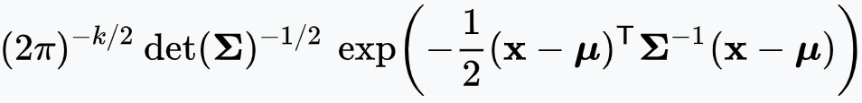
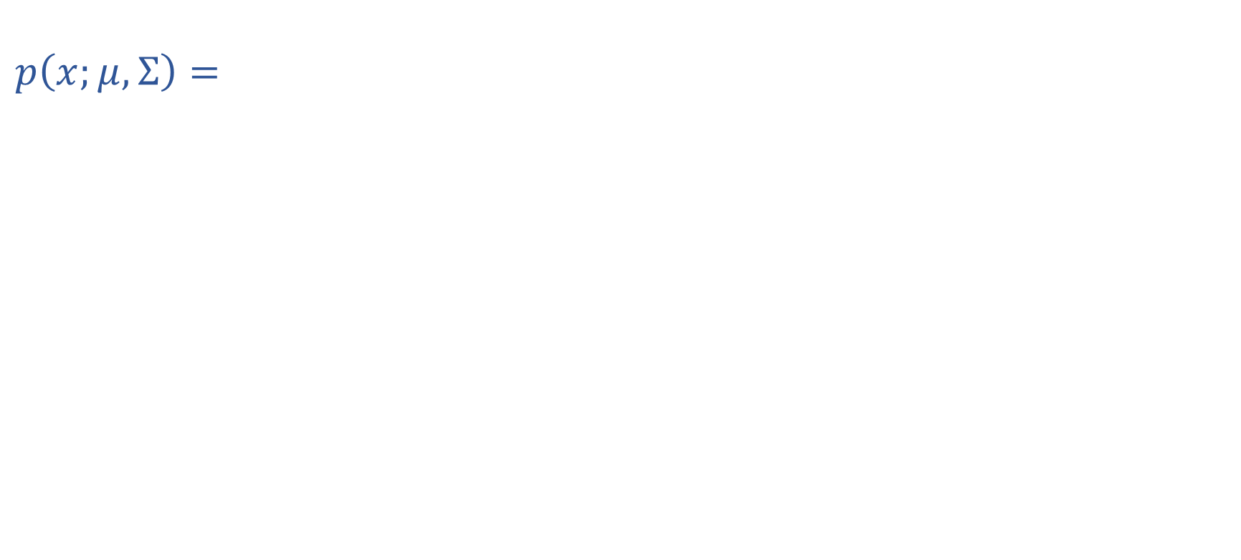
Multivariate Gaussian
$$p\left(x;μ, Σ\right)=$$
Distance from $x$ to $μ$ under norm induced by $Σ^{−1}$

Slide 22
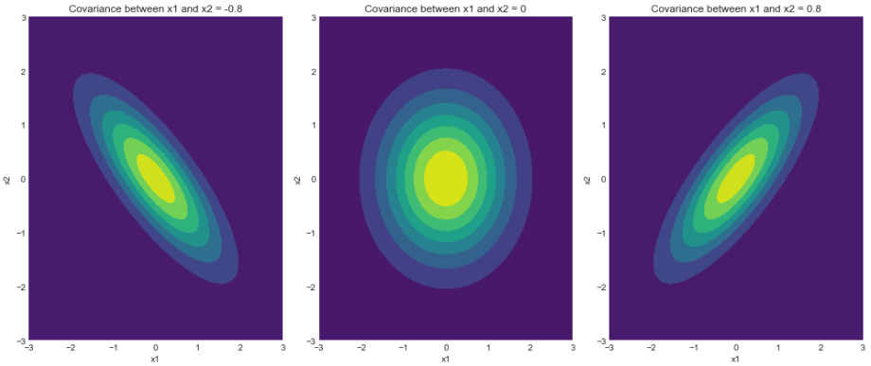
Multivariate Gaussian
https://www.geeksforgeeks.org/visualizing-the-bivariate-gaussian-distribution-in-python/

Slide 23
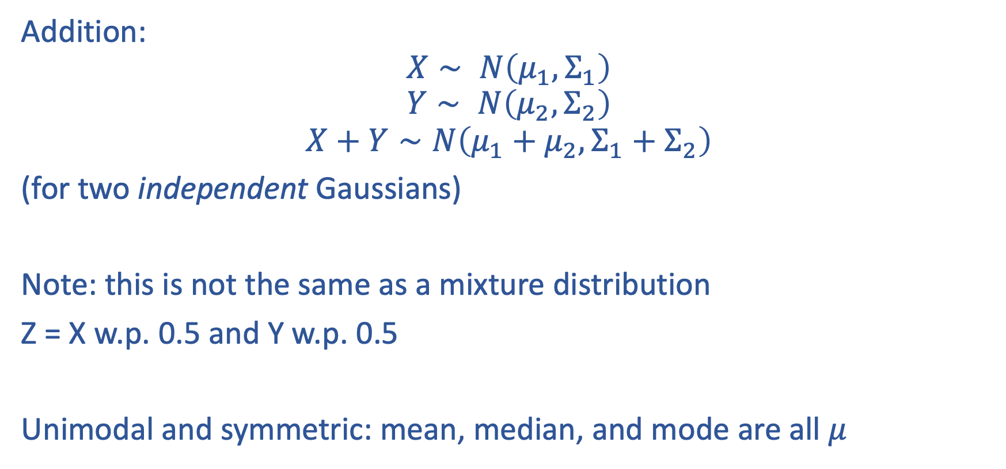
Properties of Gaussians
Addition:
$$X∼ N\left(μ_{1}, Σ_{1}\right)$$
$$Y∼ N\left(μ_{2}, Σ_{2}\right)$$
$$X+Y∼N\left(μ_{1}+μ_{2}, Σ_{1}+Σ_{2}\right)$$
(for two independent Gaussians)
Note: this is not the same as a mixture distribution
Z = X w.p. 0.5 and Y w.p. 0.5
Unimodal and symmetric: mean, median, and mode are all $μ$

Slide 24
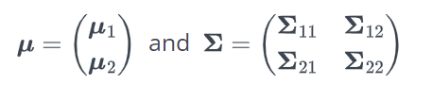
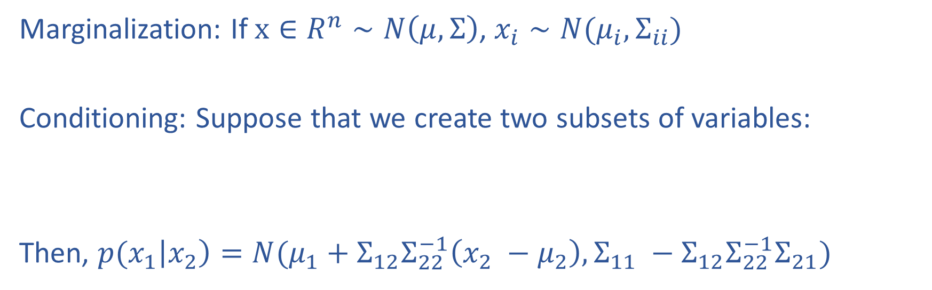
Properties of Gaussians
Marginalization: If $x∈R^{n}∼N\left(μ, Σ\right)$, $x_{i}∼N(μ_{i}, Σ_{ii})$
Conditioning: Suppose that we create two subsets of variables:
Then, ${p(x}_{1}\left|x_{2}\right)=N(μ_{1}+Σ_{12}Σ_{22}^{−1}\left(x_{2} −μ_{2}\right), Σ_{11} −Σ_{12}Σ_{22}^{−1}Σ_{21})$

Slide 25
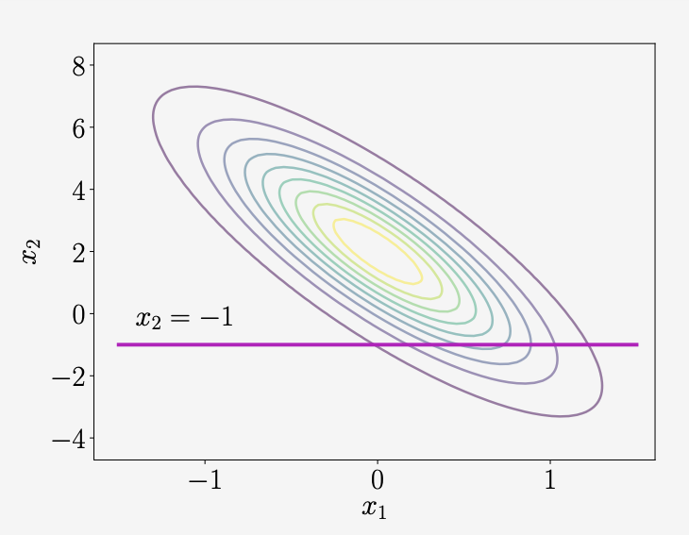
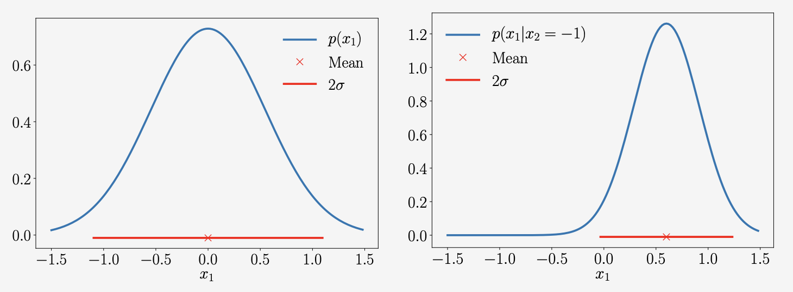
Example
Marginal
Conditional

Slide 26
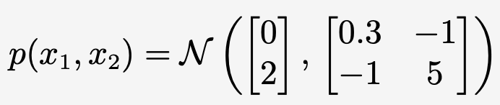
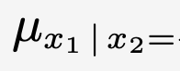
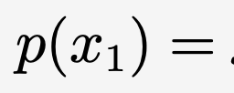
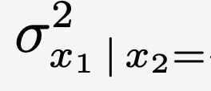
Example

